Slide 1
A short history of measurement, and some thoughts on trust and specifications

Slide 2












@mirfaan
Business Analyst
Product Owner
STWC runner up!

Slide 3
1 metre
Notes:
Spread your arms out, compare metres
Lets get the biggest and smallest

Slide 4
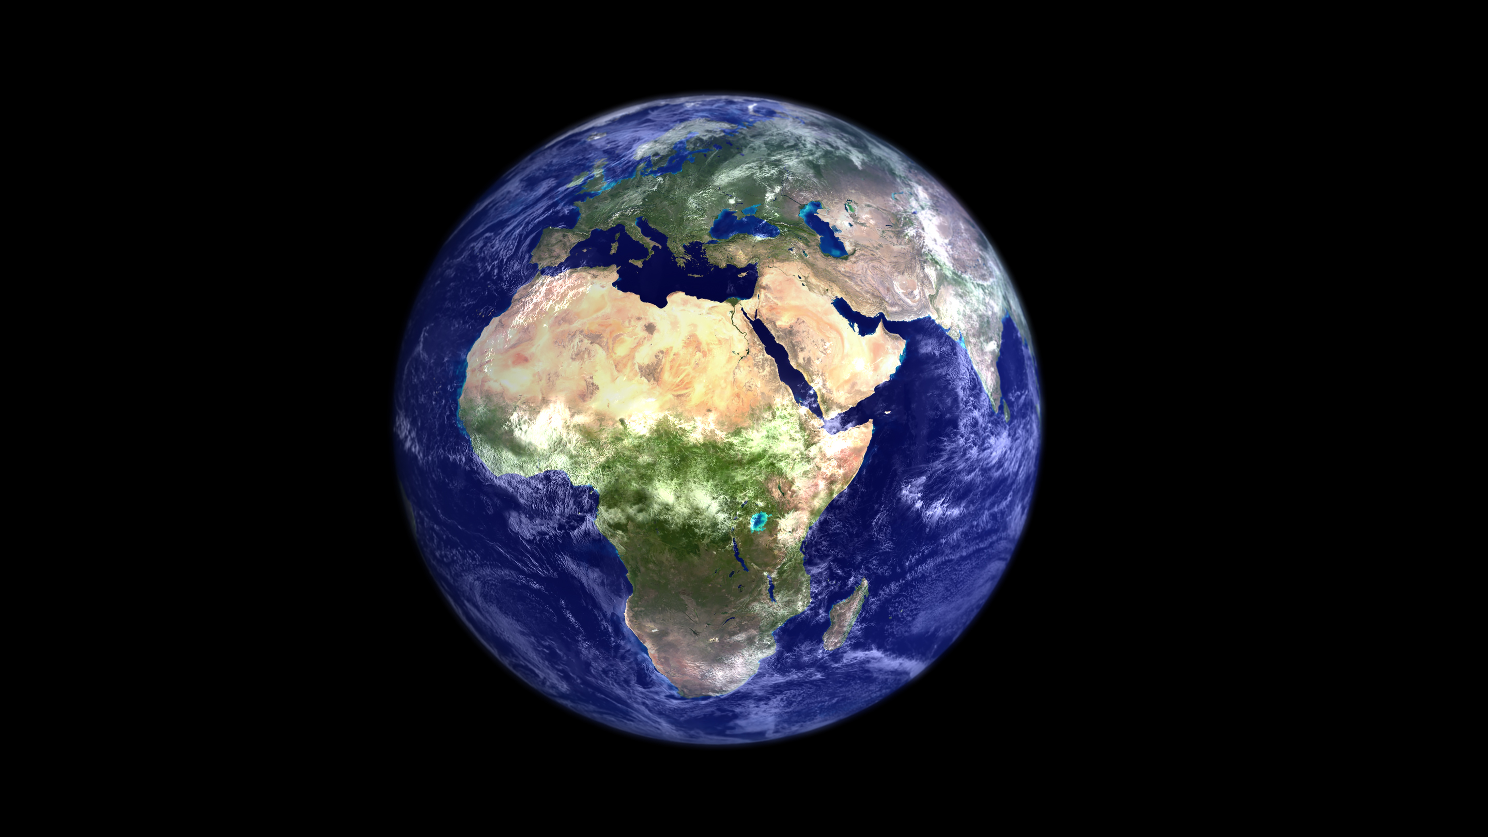
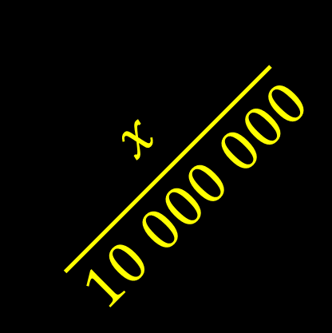
le north pole
$$\frac{x}{10 000 000}$$
le equator
Notes:
Decided in 1799
Created the metre bar
Bar was changed in 1889
1960 metre defined in terms of krypton emissions
1983 new definition

Slide 5


Slide 6
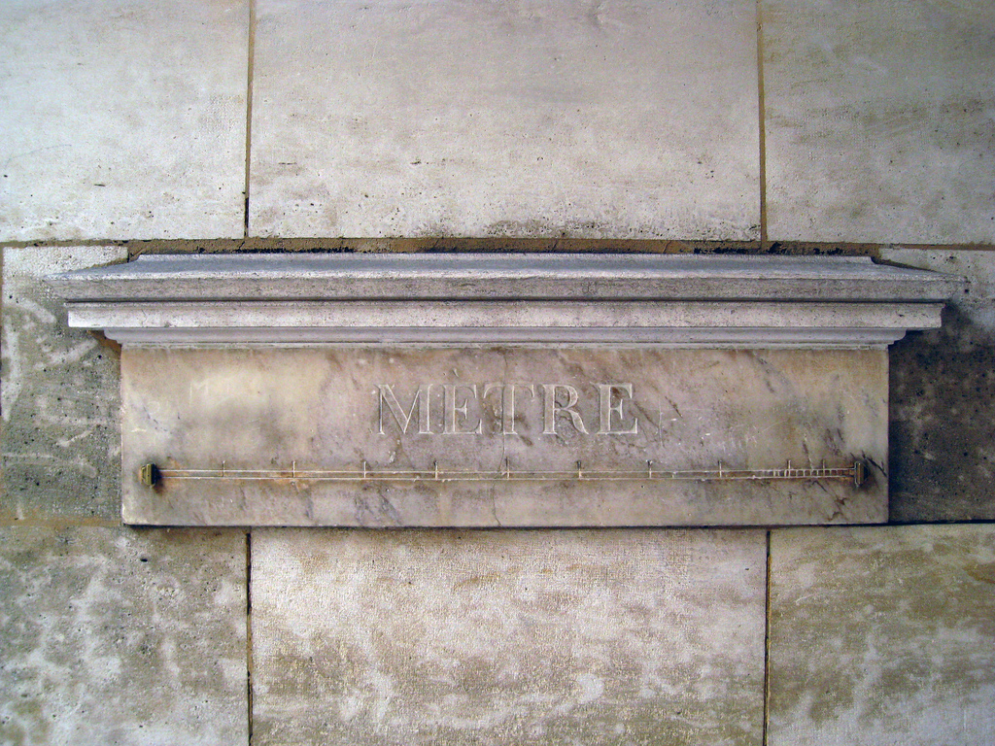
1796
Notes:
Between 1796 and 1797, 16 prototype meters were carved in marble and placed throughout Paris. 5 years earlier, the French Academy of Sciences had properly defined the meter as a standard unit of length, instead of inches or feet.
Prototype Meter of 36, Vaugirard Street

Slide 7
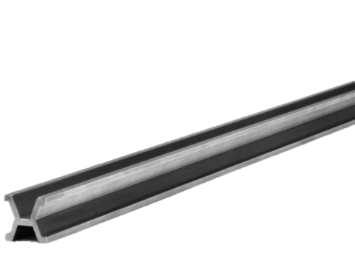
1889
Notes:
90% platinum and 10% iridium, which is significantly harder than pure platinum, and have a special X-shaped cross section (a "Tresca section", named after French engineer Henri Tresca) to minimise the effects of torsional strain during length

Slide 8
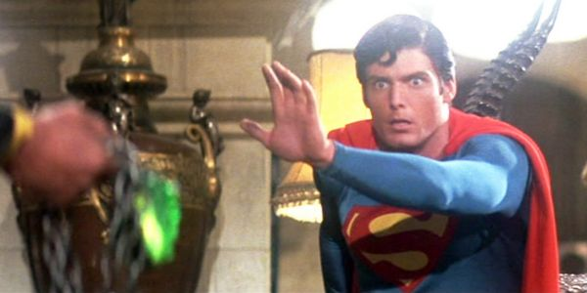
1 650 763.73 wavelengths of the orange-red emission line in the electromagnetic spectrum of the krypton-86 atom in a vacuum
1960
Notes:
Number of wavelengths of red-orange emission line of krypton-86[edit]
In 1893, the standard metre was first measured with an interferometer by Albert A. Michelson, the inventor of the device and an advocate of using some particular wavelength of light as a standard of length. By 1925, interferometry was in regular use at the BIPM. However, the International Prototype Metre remained the standard until 1960, when the eleventh CGPM defined the metre in the new International System of Units (SI) as equal to 1 650 763.73 wavelengths of the orange-red emission line in the electromagnetic spectrum of the krypton-86 atom in a vacuum.^{[16]}

Slide 10
Resolution 1 of the 17th CGPM (1983)
considering
that the present definition does not allow a sufficiently precise realization of the metre for all requirements,
that progress made in the stabilization of lasers allows radiations to be obtained that are more reproducible and easier to use than the standard radiation emitted by a krypton 86 lamp,
that progress made in the measurement of the frequency and wavelength of these radiations has resulted in concordant determinations of the speed of light whose accuracy is limited principally by the realization of the present definition of the metre,
that wavelengths determined from frequency measurements and a given value for the speed of light have a reproducibility superior to that which can be obtained by comparison with the wavelength of the standard radiation of krypton 86,
that there is an advantage, notably for astronomy and geodesy, in maintaining unchanged the value of the speed of light recommended in 1975 by the 15th CGPM in its Resolution 2 (c = 299 792 458 m/s),
that a new definition of the metre has been envisaged in various forms all of which have the effect of giving the speed of light an exact value, equal to the recommended value, and that this introduces no appreciable discontinuity into the unit of length, taking into account the relative uncertainty of ~4x10^{–9} of the best realizations of the present definition of the metre,
that these various forms, making reference either to the path travelled by light in a specified time interval or to the wavelength of a radiation of measured or specified frequency, have been the object of consultations and deep discussions, have been recognized as being equivalent and that a consensus has emerged in favour of the first form,
that the Comité Consultatif pour la Définition du Mètre (CCDM) is now in a position to give instructions for the practical realization of such a definition, instructions which could include the use of the orange radiation of krypton 86 used as standard up to now, and which may in due course be extended or revised
Notes:
Conference Generale des Poids et Mesures
The General Conference on Weights and Measures

Slide 11
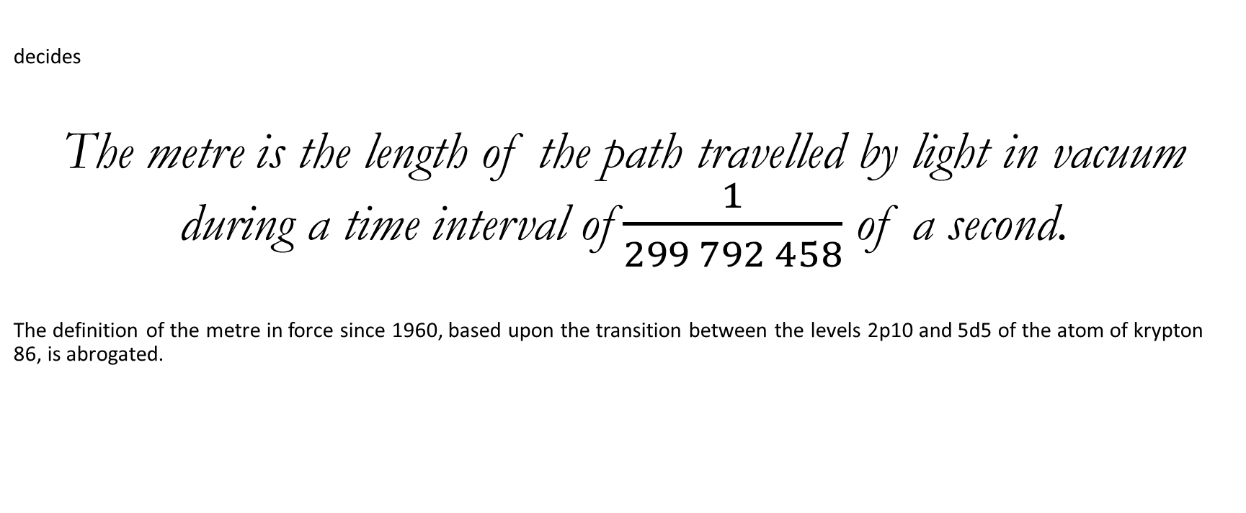
Resolution 1 of the 17th CGPM (1983)
decides
The metre is the length of the path travelled by light in vacuum during a time interval of $\frac{1}{299 792 458}$ of a second.
The definition of the metre in force since 1960, based upon the transition between the levels 2p10 and 5d5 of the atom of krypton 86, is abrogated.
Source: http://www.bipm.org/en/CGPM/db/17/1/

Slide 12
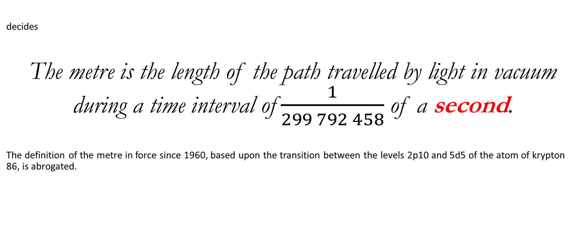
Resolution 1 of the 17th CGPM (1983)
decides
The metre is the length of the path travelled by light in vacuum during a time interval of $\frac{1}{299 792 458}$ of a second.
The definition of the metre in force since 1960, based upon the transition between the levels 2p10 and 5d5 of the atom of krypton 86, is abrogated.
Source: http://www.bipm.org/en/CGPM/db/17/1/

Slide 13
1 second

Slide 14
Resolution 1 of the 13th CGPM (1967)
considering
that the definition of the second adopted by the Comité International des Poids et Mesures (CIPM) in 1956 (Resolution 1) and ratified by Resolution 9 of the 11th CGPM (1960), later upheld by Resolution 5 of the 12th CGPM (1964), is inadequate for the present needs of metrology,
that at its meeting of 1964 the Comité International des Poids et Mesures (CIPM), empowered by Resolution 5 of the 12th CGPM (1964), recommended, in order to fulfil these requirements, a caesium atomic frequency standard for temporary use,
that this frequency standard has now been sufficiently tested and found sufficiently accurate to provide a definition of the second fulfilling present requirements,
that the time has now come to replace the definition now in force of the unit of time of the Système International d'Unités by an atomic definition based on that standard,
decides
The SI unit of time is the second defined as follows:
"The second is the duration of 9 192 631 770 periods of the radiation corresponding to the transition between the two hyperfine levels of the ground state of the caesium 133 atom";
Resolution 1 adopted by the CIPM at its meeting of 1956 and Resolution 9 of the 11th CGPM are now abrogated.
Source: http://www.bipm.org/en/CGPM/db/13/1/

Slide 15
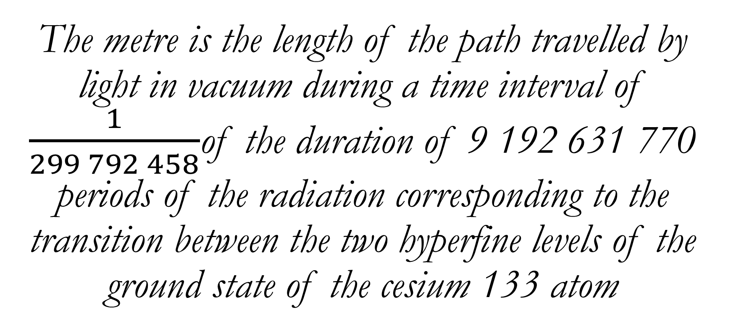
1 metre:
The metre is the length of the path travelled by light in vacuum during a time interval of $\frac{1}{299 792 458}$of the duration of 9 192 631 770 periods of the radiation corresponding to the transition between the two hyperfine levels of the ground state of the cesium 133 atom

Slide 17
1 kilogram

Slide 18
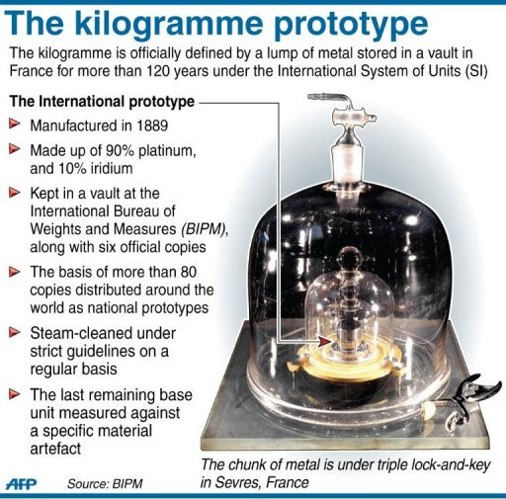
https://phys.org/news/2011-11-quandary-kilo-triggers-weighty-reflexion.html
Notes:
1992: lost weight

Slide 19
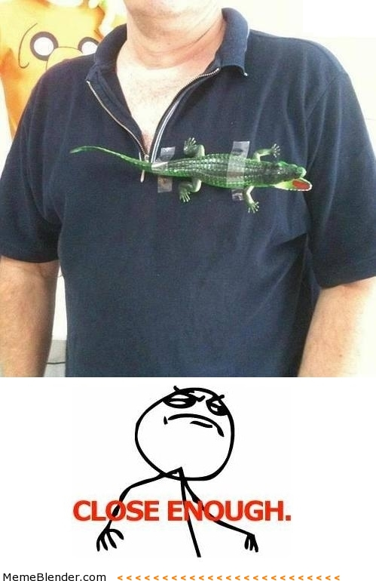

Slide 20
A short history of measurement, and some thoughts on trust and specifications

Slide 21

In order to test something well, you need to deeply understand the underlying systems,
so that you understand points of integration and edge cases
Sent: 2015
In order to test something well,
You need to deeply understand the underlying systems
motivations of the system and users
So that you understand points of integration and edge cases
have a framework for dealing with emerging solutions
Sent: 2017
You probably need both
Sent 2019

Slide 22
Motivation

Slide 23
How might we do this?

Slide 24

Personas
http://www.slideshare.net/TheConartist/what-are-personas-and-how-to-use-them-a-presentation-by-shlomo-goltz

Slide 25
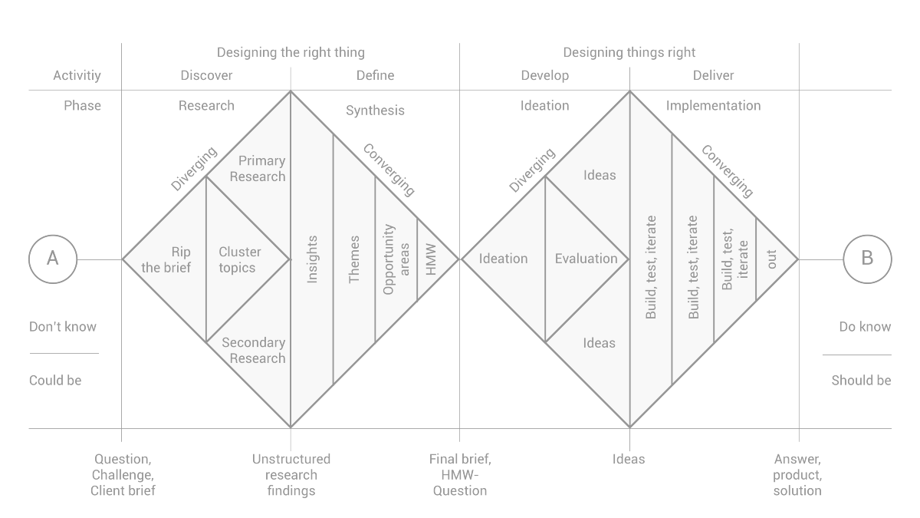
Human Centred Design “Design thinking”
https://medium.com/digital-experience-design/how-to-apply-a-design-thinking-hcd-ux-or-any-creative-process-from-scratch-b8786efbf812#.24mfwd31y

Slide 26
User stories
Titles that are outcome based
Describe the motivation
Add a button that is #ff0000 with the word “submit” to the page
The user is able to easily see how they can submit their information

Slide 27
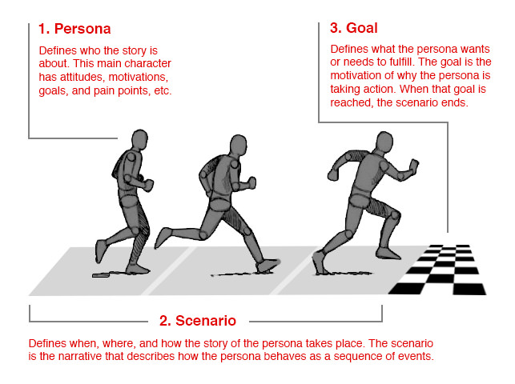
https://www.smashingmagazine.com/2014/08/a-closer-look-at-personas-part-1/

Slide 28
Examples

Slide 29
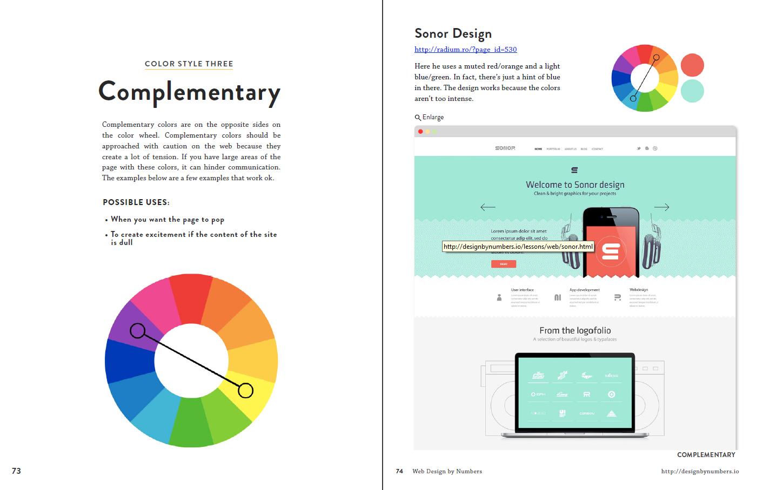
http://designbynumbers.io/media/chapter_eight_color.pdf

Slide 30

http://styleguide.mailchimp.com/writing-legal-content/

Slide 31
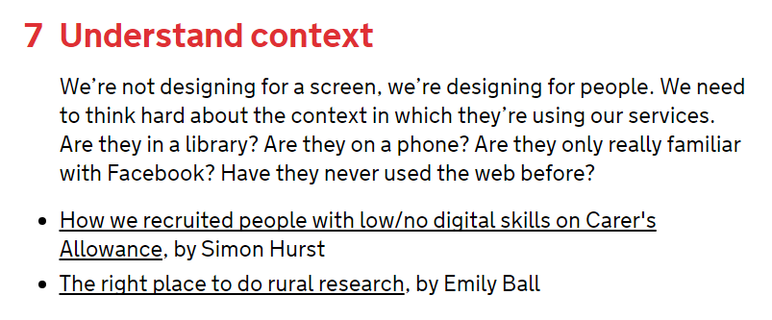
https://www.gov.uk/design-principles

Slide 32
Resources

Slide 33
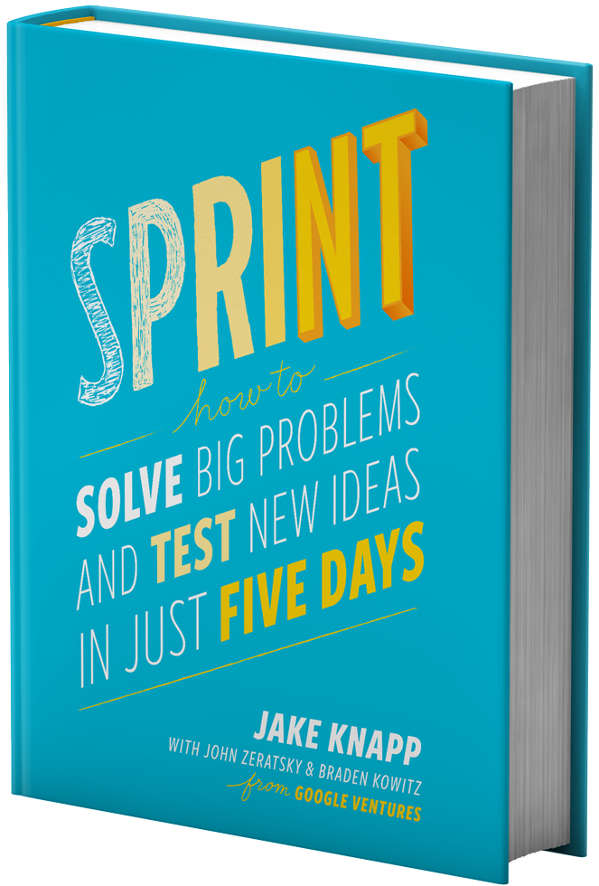
http://www.gv.com/sprint/

Slide 34
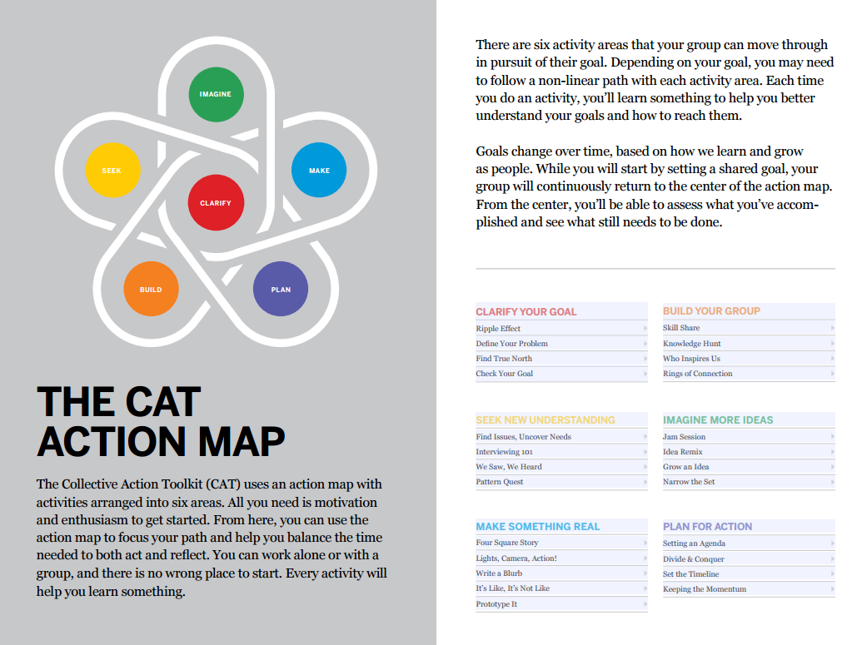
https://www.frogdesign.com/wp-content/uploads/2016/03/CAT_2.0_English.pdf

Slide 35


Slide 36
Summary

Slide 37
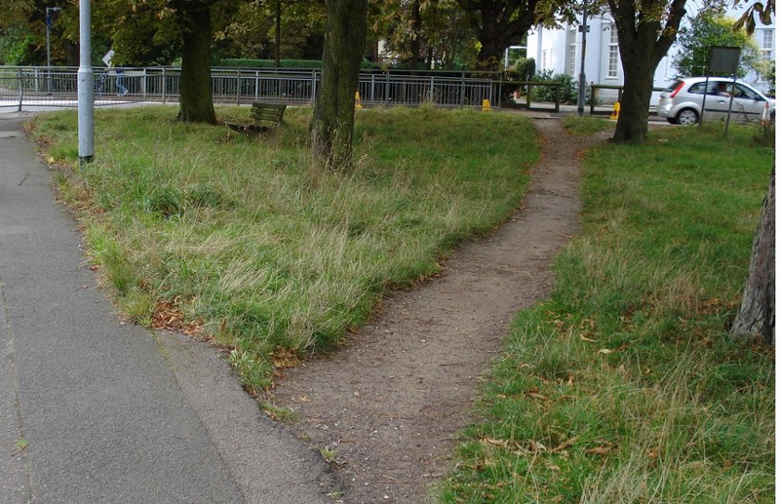
Specification
Story: The user can get from here to here
Actual work done

Slide 38
More about measurement
RadioLab: http://www.radiolab.org/story/kg/
Wikipedia: https://en.wikipedia.org/wiki/International_System_of_Units

Slide 39
Irfaan.Imamdin@allangray.co.za https://github.com/cape-town-testing

